Slide 1
Computer architecture and organization
Sneha gupta

Slide 2
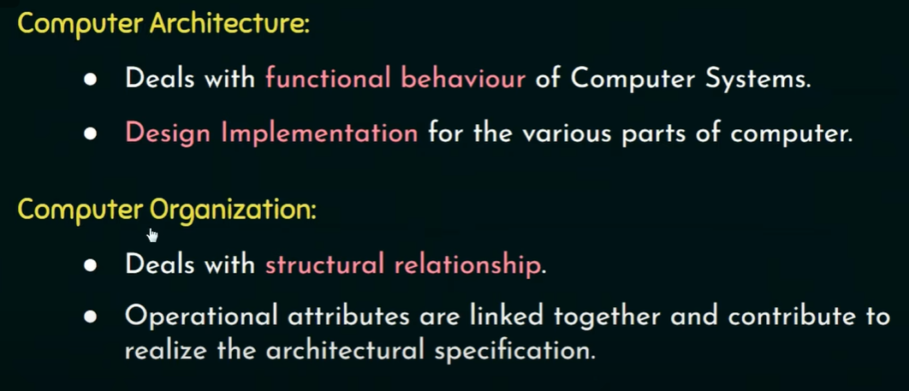

Slide 3
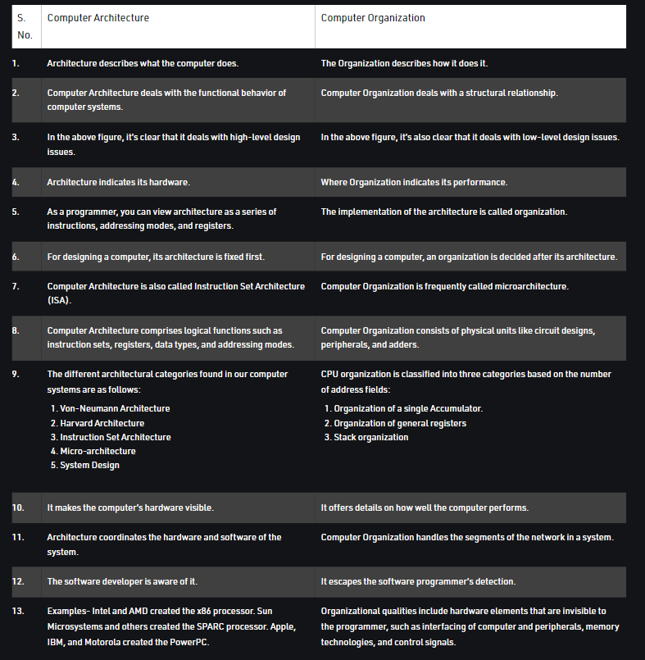

Slide 4
SOME IMP DEF:
Accumulator : an 8-bit register that is a part of arithmetic logic unit(ALU). Used to store 8 bit data to perform arithmetic and logical operations.
Semiconductor device: electronic component, relies on the electronic properties of a semiconductor material for its functions
Amplification: process of increasing the power of a signal
Rectification: process of converting alternation current (AC) to direct current (DC)
Transistors: a semiconductor device with 3 connections, capable of amplification in addition to rectification.

Slide 5
(transistor definition in terms of cao):
  Transistors are tiny device that are used to store 2 values : 1 && 0 || on && off
  if(transistor==‘on’)
    Value==1;
  Else if(transistor==‘off’)
    Value==0;
  A memory chip contains hundreds or millions or billions of transistors.
  When electric current (even though very little) passes through a transistor : value == 1; otherwise 0.
  0’s and 1’s -> building blocks of a computer.
  Combination of 1’s and 0’s -> whole new language.

Slide 6
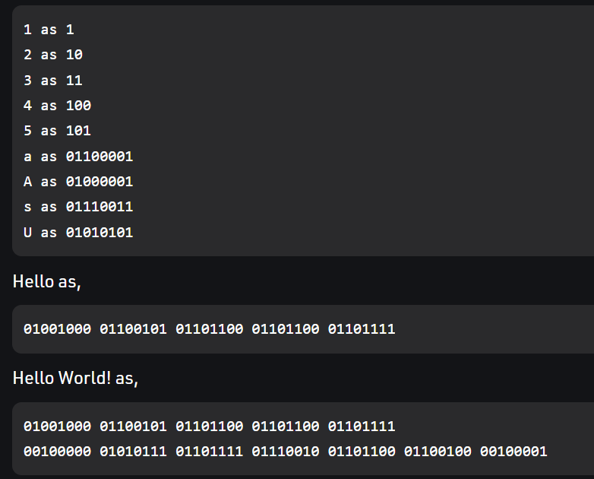
Example of creating a whole new language using 1’s and 0’s:

Slide 7
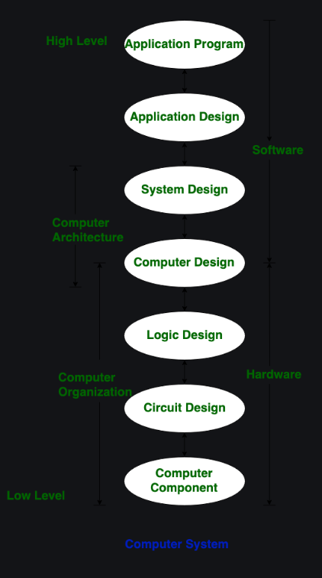

Slide 8
General purpose computers

Slide 9
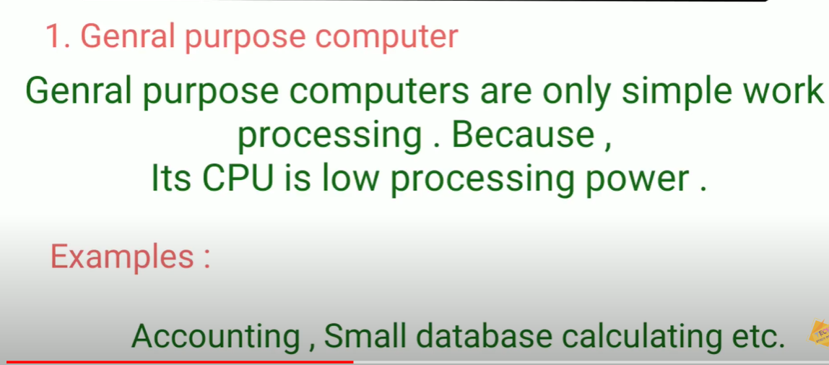

Slide 10
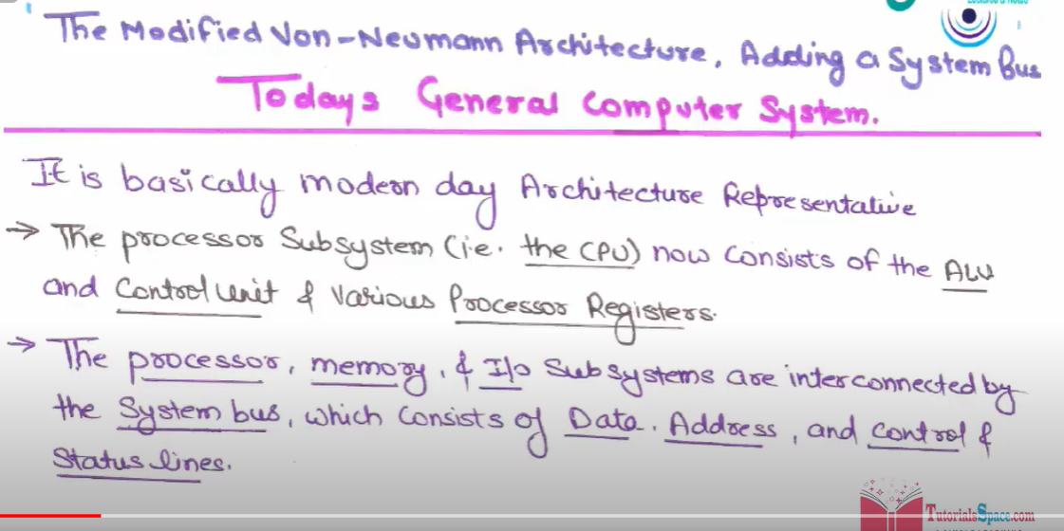

Slide 11
Gen purpose computer
Hardware
System programs
Application programs
Operating system
Memory
CPU
ALU
I/O devices
Peripheral device
An input/output unit of system that feeds data into and/or receives data from the CPU of a digital device
Storage device
Compilers
Loaders
Editors
OS(operating system)
business program
Database program
Control the allocation and use the resources among various users and tasks
Interface between hardware and programmer

Slide 12
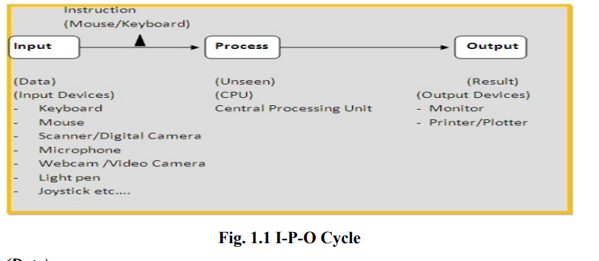

Slide 13
bus
Single bus
Multi bus
It is an open system bus architecture for gen purpose computer system. Incorporates multiple buses, allowing the designer to configure a system using the various buses to satisfy the cost and performance needs of his particular application
Single bus system has advantage of
Simplicity
Low cost
Disadvantage of
Limited speed (since only two units can participate in data transfer at any one time)
arbitration system required
Arbitration is a process where the next device becomes the bus controller by transferring the bus mastership to another bus
Units forced to wait

Slide 14
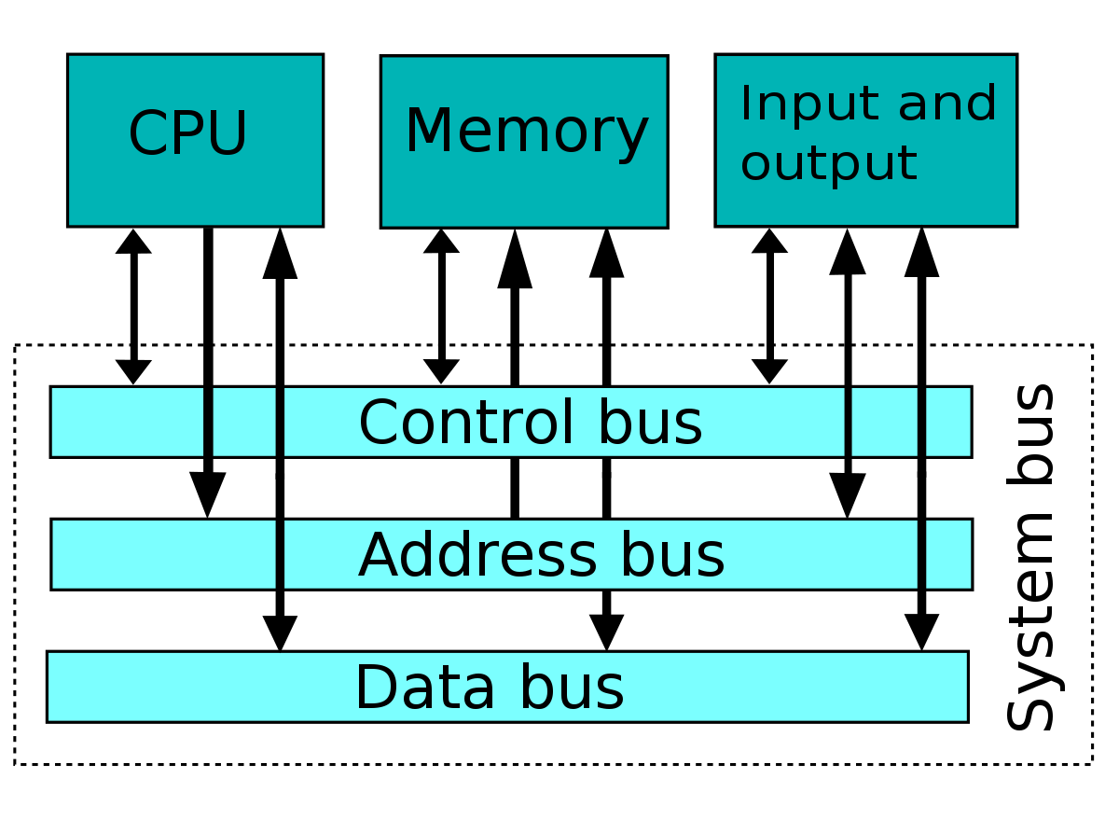
A system bus: single computer bus that connects the major components of a computer system
  Data bus: a system within a computer or a device consisting of a connector or set of wires, that provides transportation for data to CPU.
  address bus: an element in the computer CPU that transfers the location of the stored information. Sends address to RAM (random access memory)
  Control bus: used by CPU for communicating with other devices within the computer.

Slide 15
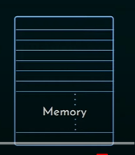
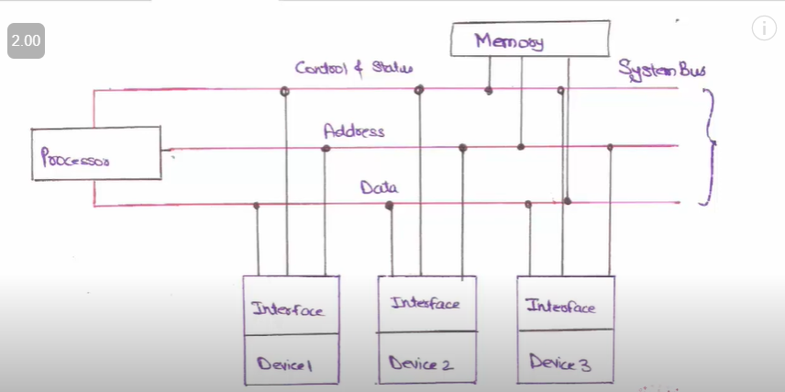
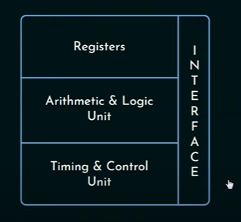
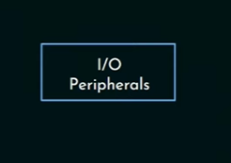
System bus diagram for examination point of view

Slide 16
Execute a program
Executed to process data (already loaded in the computer memory though input devices)
result stored:
Instructions stored in computer memory
after processing
Memory for further reference
Sent through output port

Slide 17
ALU (arithmetic logic unit)
Control unit
Registers
Used for temporary storage data
Has some special function registers
Program counters (PC)
Contains address of the instruction being executed at the current time
Instructions register (IR)
Memory address registers (MAR)
Memory data registers (MDR)
Most critical register in CPU
Monitors execution of instructions
Which instruction is being executed
What next instruction is going to be executed
Used to hold the instruction that is currently being executed
Used to handle data transfer between main memory and processor
Used to handle data transfer between main memory and processor
Holds the address of main memory to/from data to be transferred
Contains data to be written/read from the main memory
Processor
Processor is said to be “servicing” the devices
Can service in 2 ways
Polling routine
Interrupt
Checks i/o devices frequently
Tests to see if any device needs servicing or not
Provides an external asynchronous input
Form of i/o processing: permits other processing to continue before transmission has finished

Slide 18
Store program control concept (SPC)
A place where we can store and control the program

Slide 19
Computer history
ENIAC (electronic numerical integrator and computer)
  Developer: JOHN VON NEUMANN (member of ‘Eckert-Manchly’ team)
  First electronic computer
  Build : vacuum tubes
  Based: stored program concept
  Control board: program wired
    Rewiring of the control board was necessary for each computing sequence
EDVAC
  Developer: JOHN VON NEUMANN
  First stored program computer
  Structure contains:
    Input device: data and instructions enter
    Storage unit: into which results can be entered and from which instructions and data can be fetched
    Arithmetic unit: process data
    Control unit: fetch, interpret and execute the instruction from the storage
    Output: deliver the results to user

Slide 20
EDSAC
  Same time as EDVAC
  First operational stored program machine
  Introduced primary and secondary memory hierarchy

Slide 21
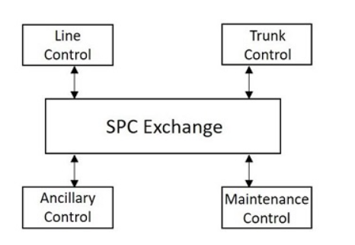
Basic structure : spc

Slide 22
SPC
Centralized spc
Distributed spc
previous version: Single processor to perform exchange functions
Now version: dual processor
Process->more reliable
Standby mode
Synchronous duplex mode
Load sharing mode
One processor-> active; other->used as backup (if active->fails; backup processor->used)
Secondary storage->common to both processor
Both processors -> not directly connected
Two processors-> connected && operated in synchronism
Separate memories
Comparator->connected -> used to compare the results -> identifies if any fault occurred -> faulty processor identified by operating them individually -> faulty processor bought into service->other processor serves
Both receives data separately; only one controls the exchange
Task shared b/w two processors
ED(exclusion device) used instead comparator -> call for ed to share resources (so that both processors do not seek same resource)
Both processors active
If one processor fails-> other takes entire load
Has special type of processors-> regional processors
Centralized spc helps this spc by directing them
More availability && reliability

Slide 23
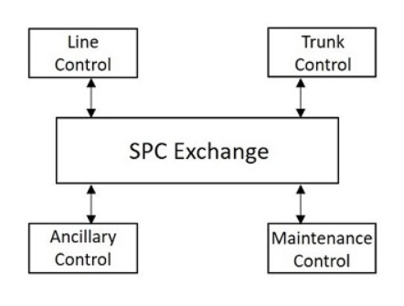
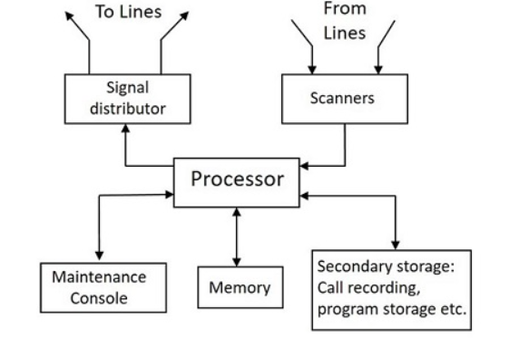
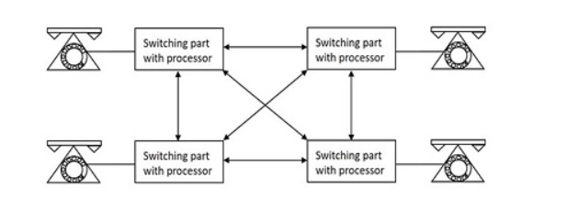
SPC
CENTRAILISED SPC
DISTRIBUTED SPC

Slide 24
Cache memory

Slide 25
A faster and smaller segment of memory whose access time is close as registers and smaller than that of primary memory
Cache memory is smaller, large amount of data cannot be stored
Need:
  Data in primary mem (accessed in microseconds) -> accessed faster than secondary mem
  Cpu capable of accessing memory in nanoseconds
  Cpu not being used efficiently (may remail idle for some time)
  Hence, cache memory introduced
Working:
  Cpu searches for data needed in cache
    If(data found==true)
      Process data accordingly //cache hit occured
    Else
      Search for data in primary memory (slower process)
      Load it in the cache //cache miss occured
      //minimizes the time required to access the data next time.
Performance:
  Hit ratio(measuring of performance of data)=number of cache hits/number of searches
  90%>=good cache (most request satisfied)
  80<=inefficient cache, poor configuration

Slide 26
Cache memory(types)
L1/ level 1 cache
L2/ level 2 cache
L3/ level 3 cache
Present in Every core of processor
Small amount
Size: 2KB-64KB
Inside/outside CPU
If(outside)->can be shared b/w 2 cores
Connected to processor w/ high speed bus
Size: 256KB-512KB
Outside CPU
Shared by all cores
Size: 1MB-8MB

Slide 27
RAM
CACHE
Large in size : 1MB-16GB
Stores data currently being processed by the cpu
Interacts w/ secondary memory to store
Ensures that data Is loaded before accessing, ram miss never occurs
Small in size: 2KB-8MB
holds frequently accessed data
Interacts w/ primary memory to store
Searches for data, of not, cache miss occurs

Slide 28
Computer architecture classifications
Von Neumann and Harvard architecture

Slide 29
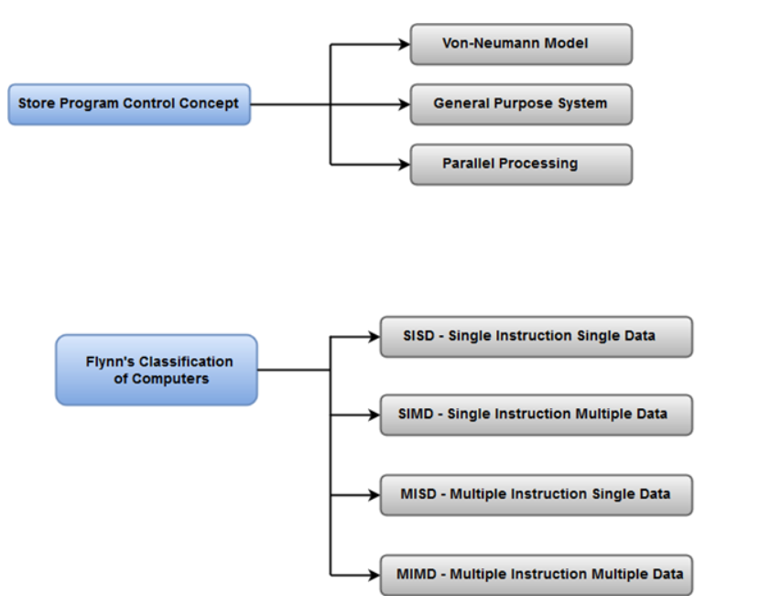
{
General system architecture

Slide 30
Basic definations:
Cycle time: time b/w the start of one RAM access to time when the next access starts
Clock cycle: helps understand CPU’s speed -> single electronic pulse of CPU -> 1 clock cycle: fetching an instruction, accessing memory, writing data; thus, sometimes require multiple clock cycles

Slide 31
Von Neumann architecture/Princeton architecture
Harvard architecture
Based: Stored program computer concept
Same memory for instructions and data
Single processor
Common bus for data and instructions
2 clock cycles required to execute
Cheaper
CPU cannot access instructions and read/write at the same time
Used: personal and small computers
Based: Harvard mark 1 relay based model
Separate memory used for instructions and data
2 processors
Separate bus for data and instructions
1 clock cycle required to execute
Costly comparatively
CPU can access instructions and read write at the same time
Used: micro controllers and signal processing

Slide 32
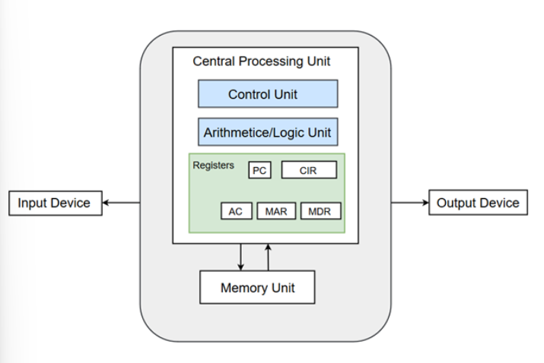
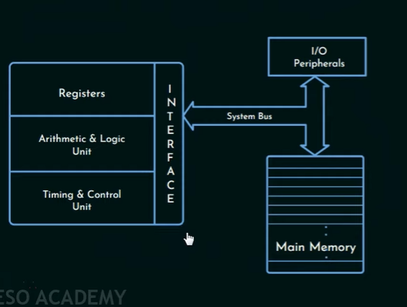
Von Neumann model

Slide 33
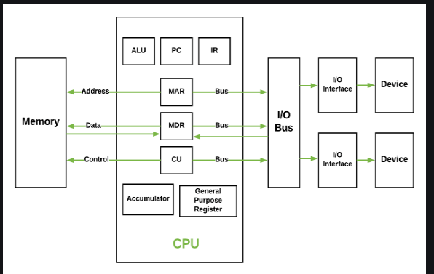
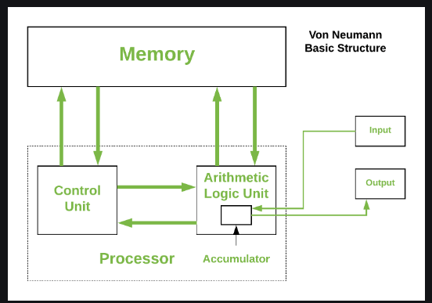

Slide 34
Von Neumann structure
CPU
Main memory unit
Input/output device
Control unit (CU)
Arithmetic logic unit (ALU)
Registers
Accumulator (AC)
Program counter (PC)
Memory address register (MAR)
Memory data register (MDR)
Current instruction register (CIR)
Instruction buffer register (IBR)
Buses
General purpose register
Data bus
Address bus
Control bus
Program or data read into main memory from input device/secondary storage.
Output device->output the info

Slide 35
CENTRAL PROCESSING UNIT (CPU)
Performs the bulk of data processing operations->CPU
Electric circuit responsible for executing the instructions of a computer program
Performs micro-operations for executing the instructions. ALU allows arithmetic and logic operations to be carried out
Control unit (CU)
Arithmetic logic unit (ALU
Handles all processor control signals. Directs all input-output flow, fetches code for instructions, controls how data moves etc.
Controls operations of components like ALU, memory and i/o device
Cu →program counter (PC) -> address of instructions to be fetched
→instruction register (IR) -> from where instructions are to be fetched from memory

Slide 36
REGISTERS: high speed storage areas in CPU. Data processed in CPU are fetched from registers.
registers
Accumulator (AC)
Stores the result of calculations made by ALU
Program counter (PC)
Memory location of next instruction to be dealt with. Next address passed to MAR.
Memory address register (MAR)
Stores memory location of instructions that needed to be stored in the memory
Memory data register (MDR)
Stores Data that is being transferred
Current instruction register (CIR)
Current instruction during the process
Instruction buffer register (IBR)
Instruction not being executed immediately placed in the IBR

Slide 37
DATA BUS
Carries data -> main memory, I/O devices, processor
ADDRESS BUS
Carries address of data -> b/w memory and processor
CONTROL BUS
Control command from CPU&&status signals from other devices

Slide 38
VON NEUMANN BOTTLENECK
Instructions can only be done at a time and only be carried out sequentially. → holds back the competence of CPU.
This is commonly referred to as von Neumann bottleneck

Slide 39
Harvard architecture
Designed to overcome Von Neumann bottleneck → can access instructions and read and write at the same time

Slide 40
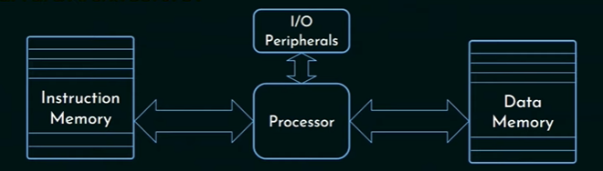
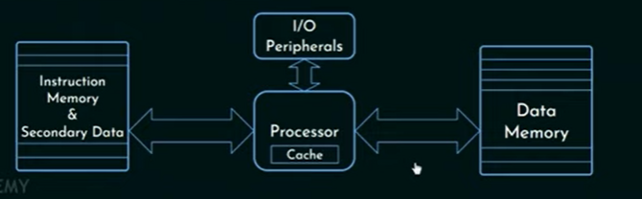
Non von Neumann architecture
Harvard architecture
Modified Harvard architecture
Two separate caches, ( data and instructions)

Slide 41
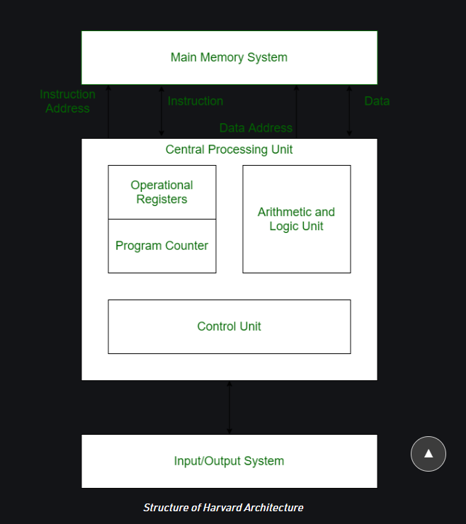

Slide 42
DATA BUS
Carries data -> main memory, I/O devices, processor
DATA ADDRESS BUS
Carries address of data -> b/w memory and processor
INSTRUCTION BUS
Carries instructions -> main memory sys, processor, I/O devices
INSTRUCTION ADDRESS BUS
Carries address of the instructions -> processor to main memory

